Slide 1
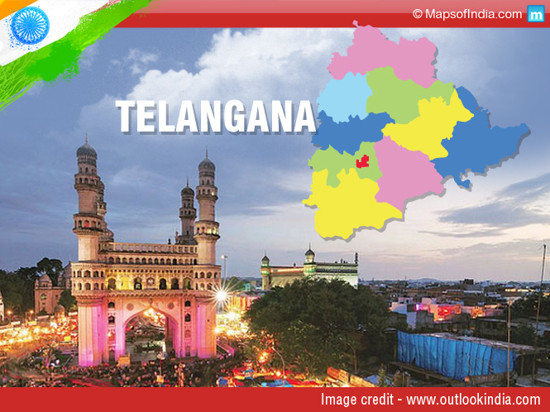
Codebasics resume challenge 7
Telangana Growth Analysis

Slide 2

I am Peter Pandey Working as a junior data analyst and currently I’m here to provide insights to Telangana growth challenge.

Slide 3

Tools Used (SQL ,MS Excel, Power BI ,MS Power Point)
Introduction to the Dataset
Primary Insights (Basic Analysis)
Secondary Insights (Suggestions & recommendations)

Slide 4

Introduction
Telangana is one of the fastest-growing states in India and one of the states with an open data policy.
(They have published all their data online)

Slide 5

Gross State Domestic Product growth rate: 14.1% over the last four years, 16.3% in 2022-23 (third-highest in India) IT sector growth: 20% in 2022-23, Rs. 1.5 lakh crore in revenue Manufacturing sector growth: 15% in 2022-23, Rs. 2 lakh crore in revenue Agriculture sector growth: 10% in 2022-23, Rs. 1 lakh crore in revenue Exports growth: 25% in 2022-23, Rs. 2 lakh crore In short, Telangana is one of the fastest-growing states in India, with strong growth in the IT, manufacturing, agriculture, and exports sectors.
Telangana: A state on the rise

Slide 6
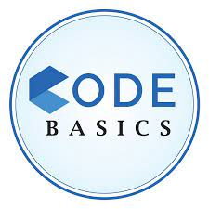


Primary insights

Slide 7

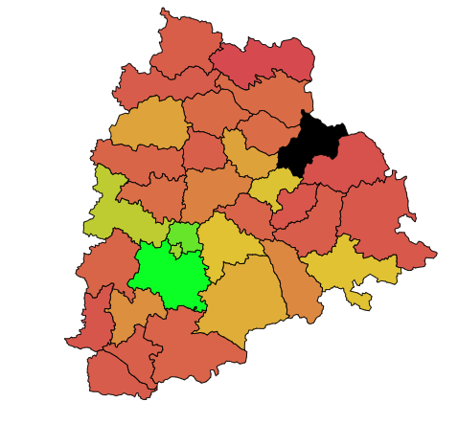
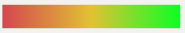
1. How does the revenue generated from document registration vary across districts in Telangana?
High revenue is generated from these districts:
Rangareddy
Medchal Malkajgiri
Sanagareddy
Remaining districts provide average revenue, as no data is given for Jayashakar Bhupalpalli it is filled with black color.

Slide 8
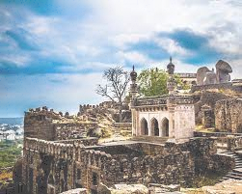
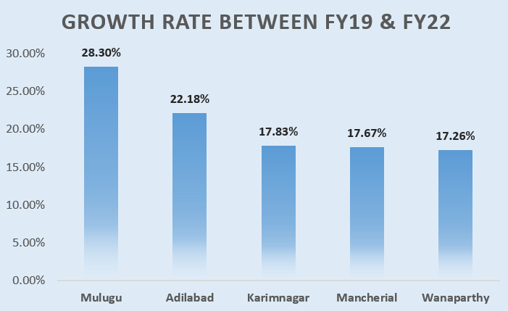
1. List down the top 5 districts that showed the highest document registration revenue growth between FY 2019 and 2022.
Certainly, here are the top five cities that have demonstrated remarkable growth in registration revenue from fiscal year 2019 to fiscal year 2022

Slide 9
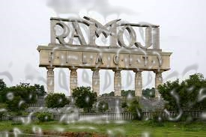
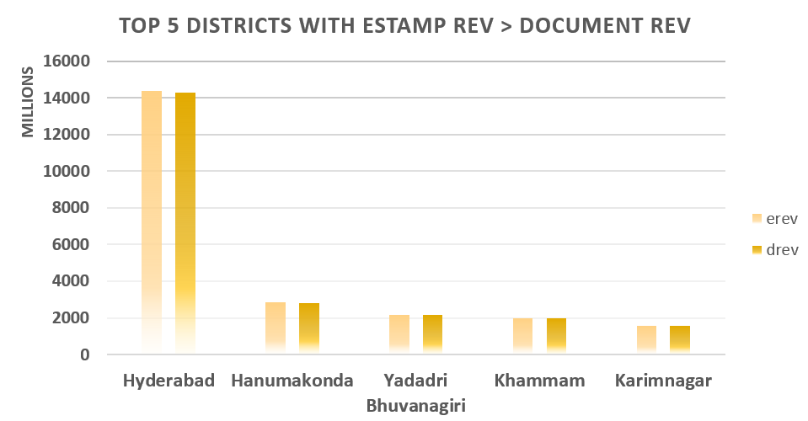
2. How does the revenue generated from document registration compare to the revenue generated from e-stamp challans across districts?
List down the top 5 districts where e-stamps revenue contributes significantly more to the revenue than the documents in FY 2022?
Stamp revenue and document revenue are closely linked. In most cases, document revenue is 1.4 times higher than e-stamp revenue. However, in Rangareddy district, document revenue is seven times higher than e-stamp revenue.
This is unusual, and it may be due to a number of factors.

Slide 10
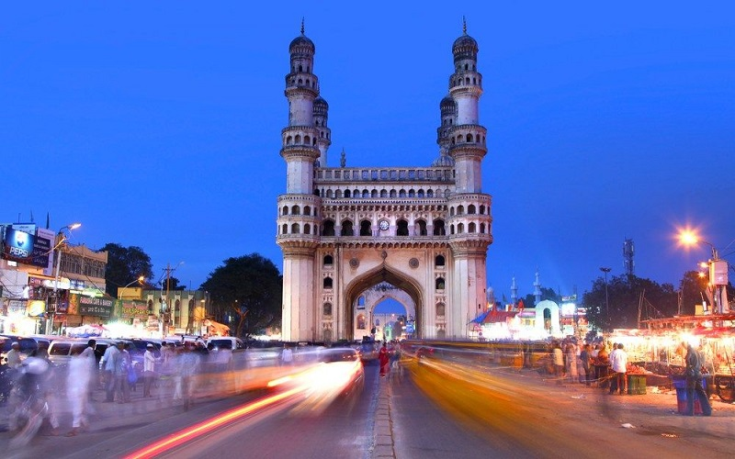
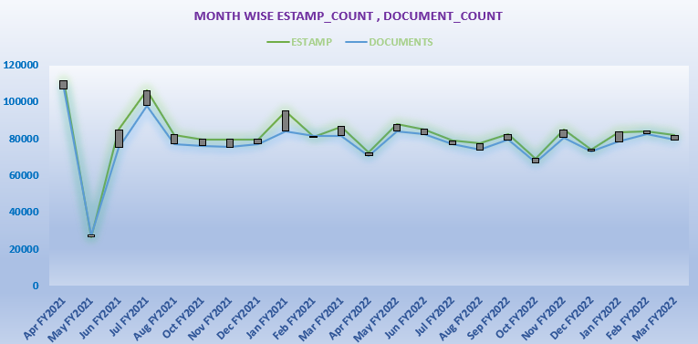
3. Is there any alteration of e-Stamp challan count and document registration count pattern since the implementation of e-Stamp challan?
We can observe that there is a fall on May 2020 and there is a strong upward curve from Jun FY21 onwards.
This is due to economic crisis in Telangana in FY20 and lockdown due to Covid19.

Slide 11
3. Is there any alteration of e-Stamp challan count and document registration count pattern since the implementation of e-Stamp challan? If so, what suggestions would you propose to the government?
Suggestions Part
Digital Integration:
Implement a comprehensive digital platform that allows users to purchase e-stamps and pay document fees online, streamlining the process and reducing physical paperwork.
As there is a decline , to increase the revenue we can follow these steps:
User-Friendly Interface:
Develop an intuitive and user-friendly interface for the e-stamp and document revenue portal to make it easy for citizens and businesses to access and use the system.
Secure Authentication:
Utilize robust authentication methods to ensure the security of online transactions and prevent fraud.

Slide 12
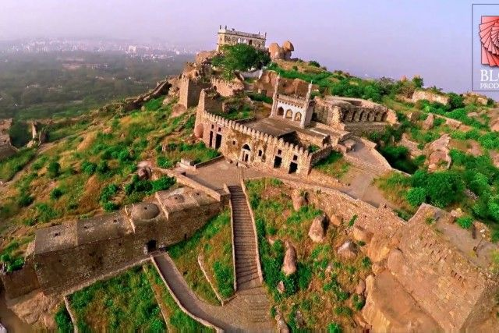
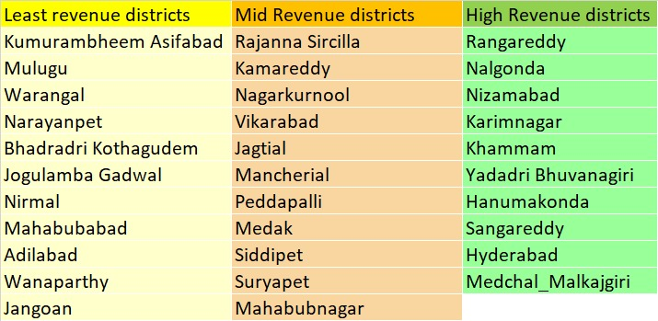
4. Categorize districts into three segments based on their stamp registration revenue generation during the fiscal year 2021 to 2022
The specific thresholds used to define each segment are as follows:
Segment 1: Top 30% of districts with the highest stamp registration revenue generation
Segment 2: Middle 35% of districts with medium stamp registration revenue generation
Segment 3: Bottom 35% of districts with the lowest stamp registration revenue generation

Slide 13
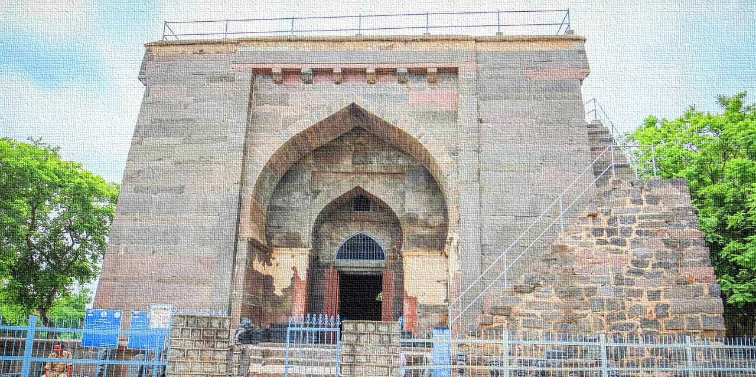
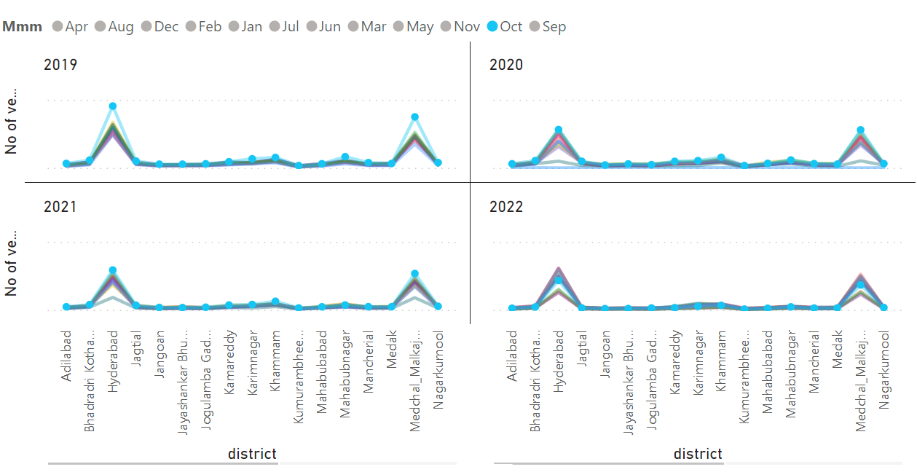
5. Investigate whether there is any correlation between vehicle sales and specific months or seasons in different districts. Are there any months or seasons that consistently show higher or lower sales rate, and if yes, what could be the driving factors? (Consider Fuel-Type category only)
We can observe that October is peak month for sales in all the districts.
No of Fuel-Vehicles sold
Hyderabad, Medchal Malkajgiri are the districts with all time high sales for all 4 years
Districts

Slide 14
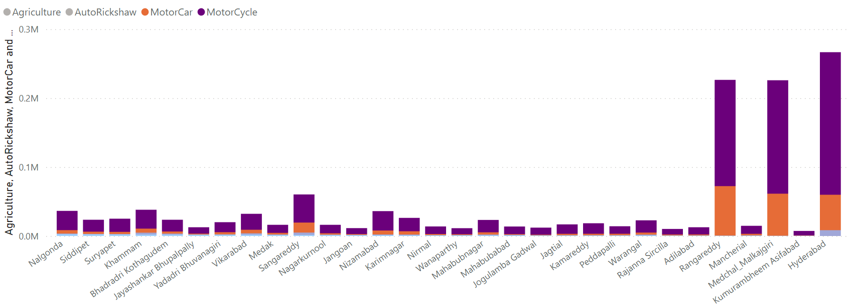
6. How does the distribution of vehicles vary by vehicle class (MotorCycle, MotorCar, AutoRickshaw, Agriculture) across different districts? Are there any districts with a predominant preference for a specific vehicle class? Consider FY 2022 for analysis.
These are the 3 districts which are given pre-dominance preference in FY22 For MotorCar & MotorCycle

Slide 15
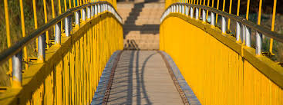
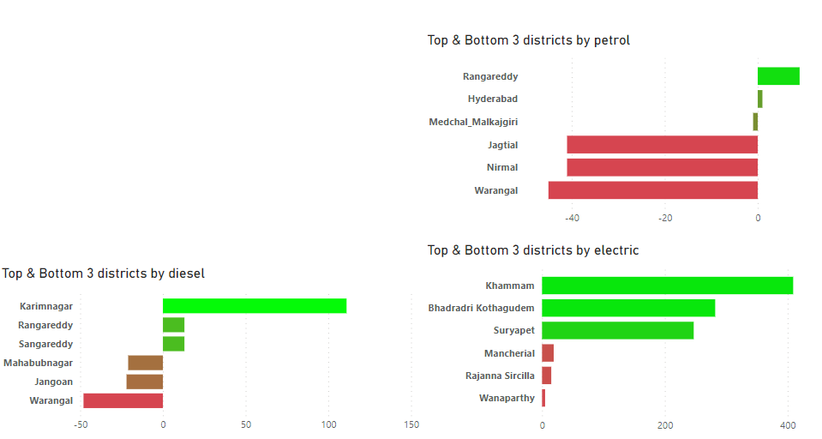
7. List down the top 3 and bottom 3 districts that have shown the highest and lowest vehicle sales growth during FY 2022 compared to FY 2021?
The growth rate of electric vehicles in Telangana has increased by 400%, which is a significant increase.
Even the bottom three districts in Telangana have a positive growth rate for electric vehicles, which indicates that the adoption of electric vehicles is widespread.
One of the top three districts Telangana state has a negative growth rate for petrol vehicles, which suggests that people are switching to electric vehicles in large numbers.
The bottom three districts in Telangana have a very high negative growth rate for petrol vehicles, which further supports the claim that people are switching to electric vehicles.
The growth rate for diesel vehicles is positive for the top three districts in Telangana, but negative for the bottom three districts. This suggests that the adoption of diesel vehicles is not as widespread as the adoption of electric vehicles.

Slide 16
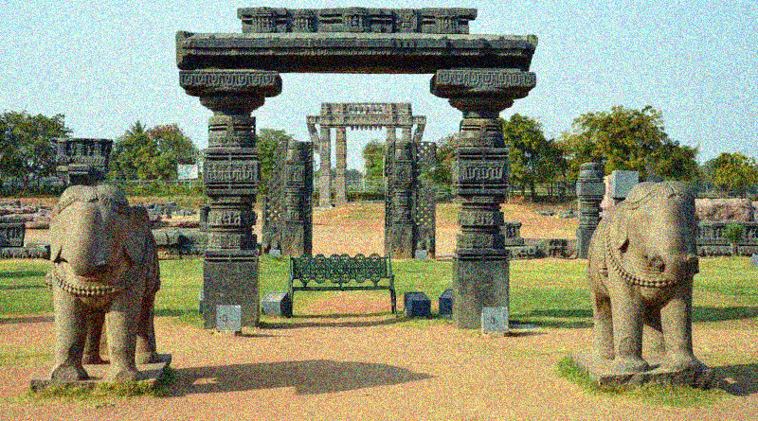
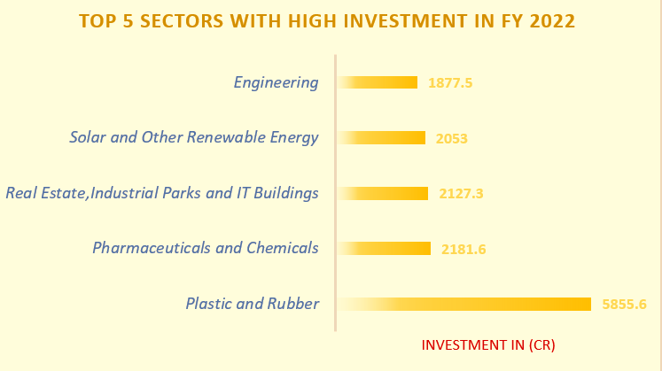
8. List down the top 5 sectors that have witnessed the most significant investments in FY 2022.
The top 5 sectors with high investments in FY22 are:
Plastic and Rubber.
Pharmaceuticals & Chemicals
Real Estate & Industrial Parks
Solar & Renewable Energy
Engineering
In FY22 Plastic and Rubber is highly invested which is one fourth of the total investments done in FY22.

Slide 17

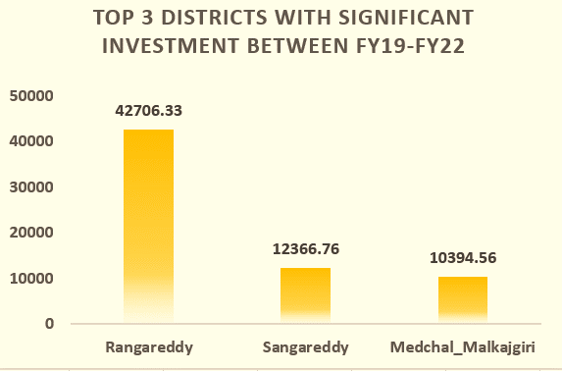
9. List down the top 3 districts that have attracted the most significant sector investments during FY 2019 to 2022? What factors could have led to the substantial investments in these particular districts?
Close to Hyderabad offers access to its economic growth and opportunities, benefiting the region.
Telangana's government policies actively attract investments to the state.
Investment in Cr
Telangana's business-friendly environment, low corruption, and innovation drive attract domestic and foreign investors, fostering economic growth.

Slide 18

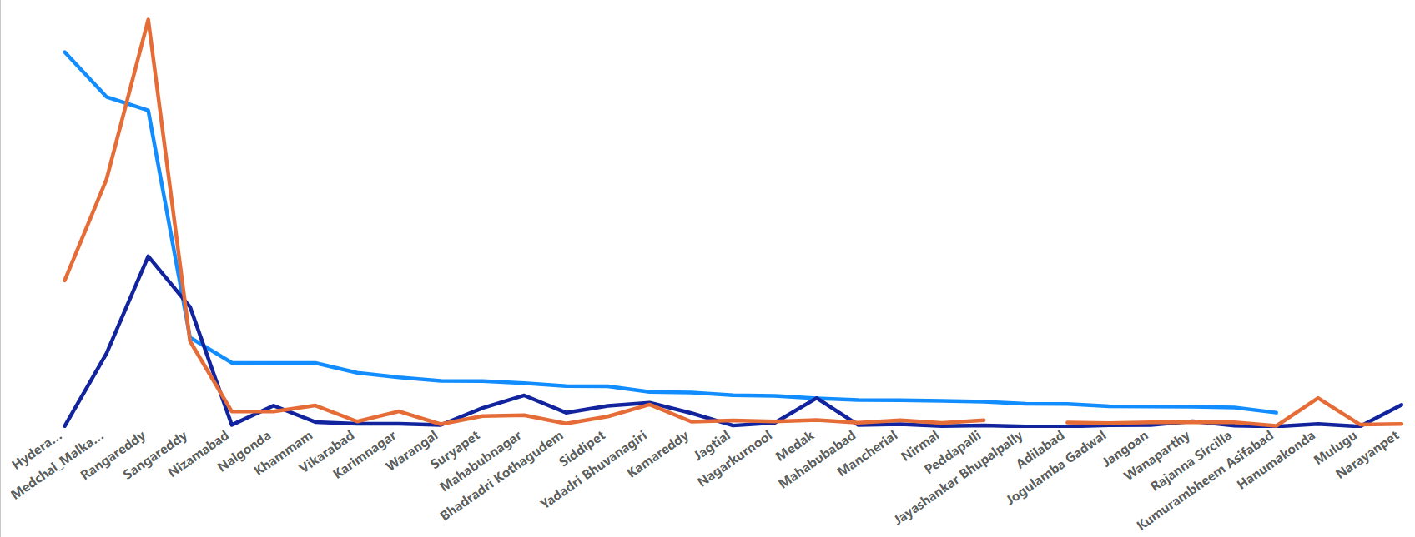
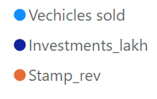
10. Is there any relationship between district investments, vehicles sales and stamps revenue within the same district between FY 2021 and 2022?
My analysis shows that:
There is a strong co-relation between the amount of stamp revenue collected and the amount of investment that is made in different districts. This means that when they are investing in sectors , they are also helping to generate stamp revenue for the government.
There is a strong link between the number of vehicles sold and the amount of stamp revenue generated. This means that when more vehicles are sold, more stamp revenue is generated.

Slide 19
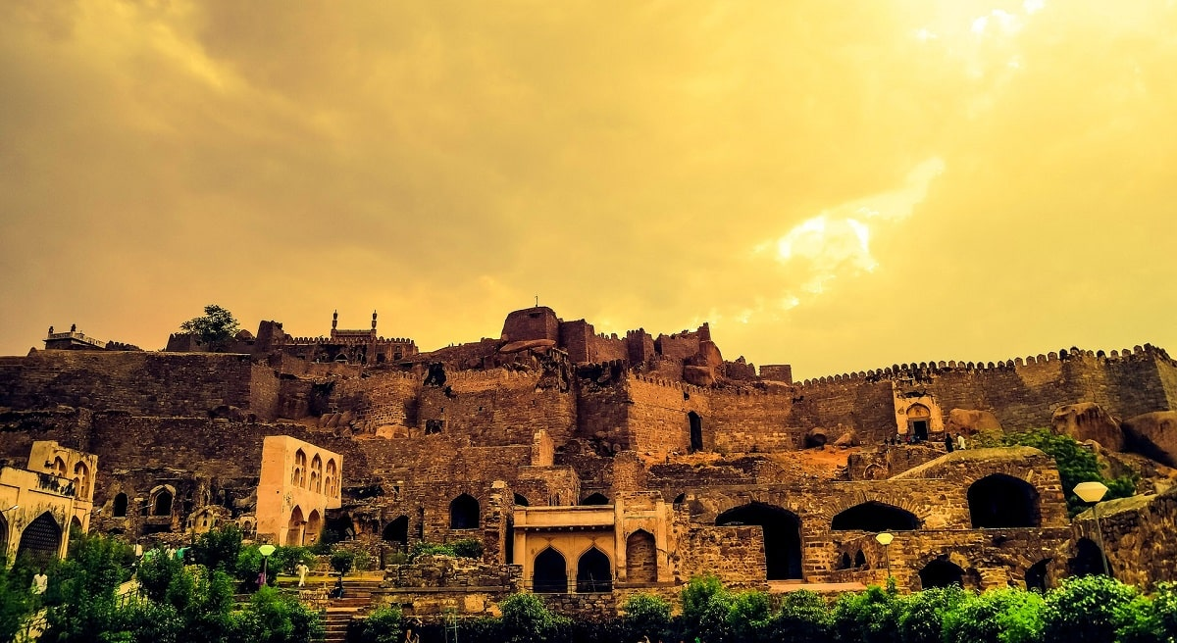
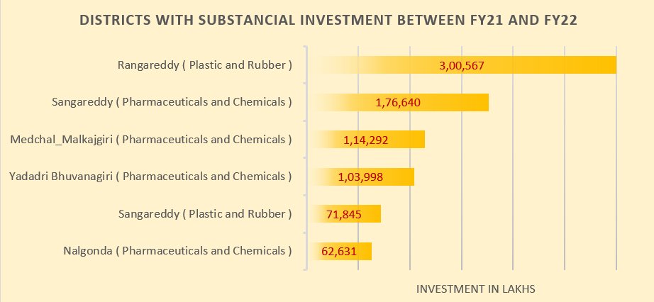
11. Are there any particular sectors that have shown substantial investment in multiple districts between FY 2021 and 2022?
The following sectors have attracted significant investment in multiple districts during the Fiscal year 2021-22

Slide 20
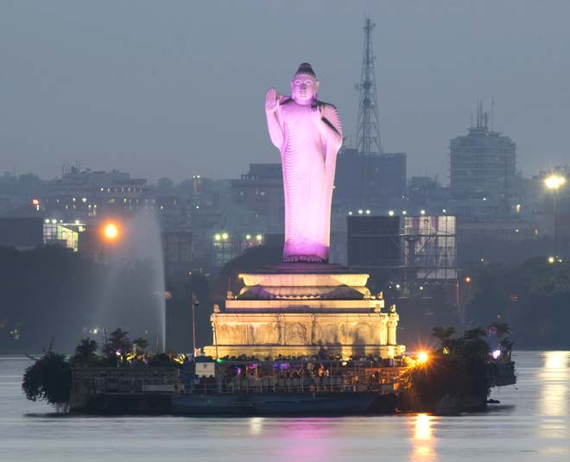
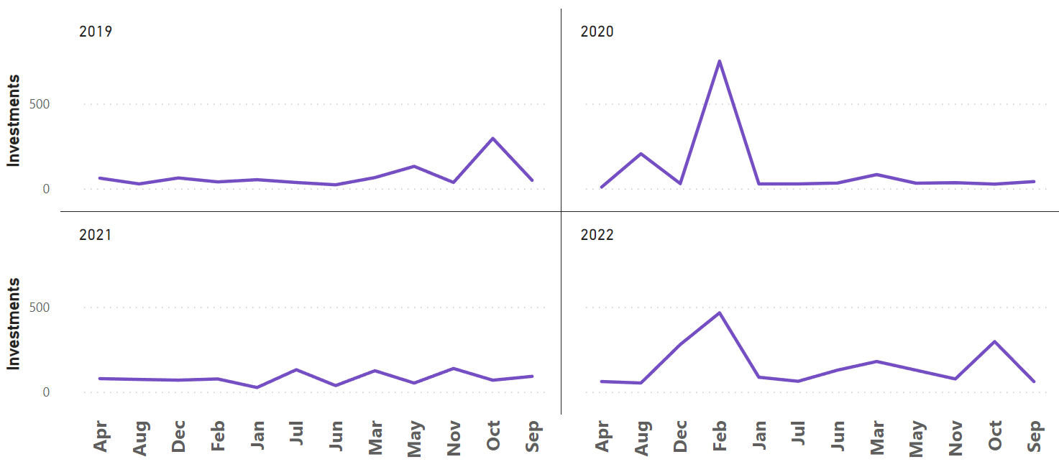
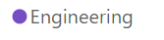
12. Can we identify any seasonal patterns or cyclicality in the investment trends for specific sectors? Do certain sectors experience higher investments during particular months?
For Engineering sector high investments are observed in the month of February or October in most of the cases.

Slide 21
Secondary insights

Slide 22
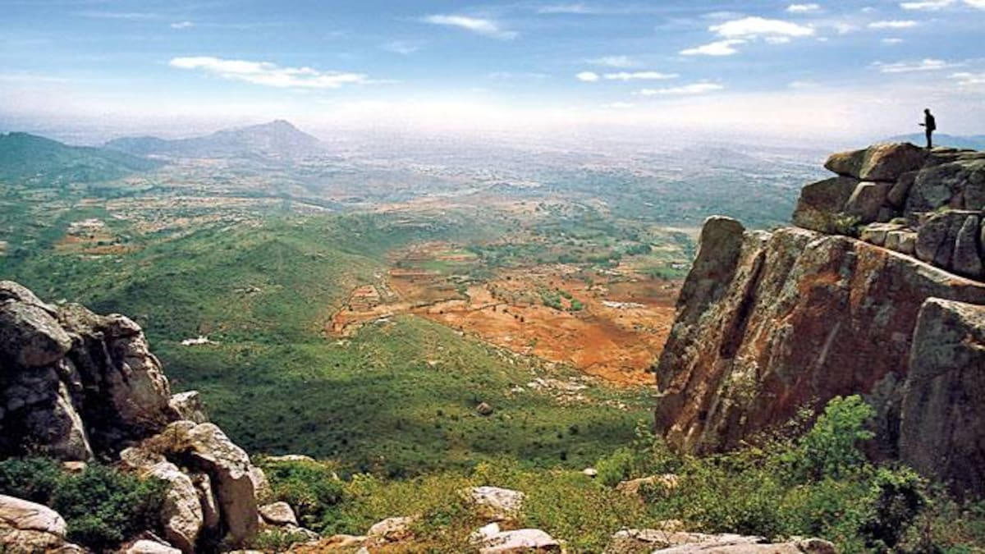
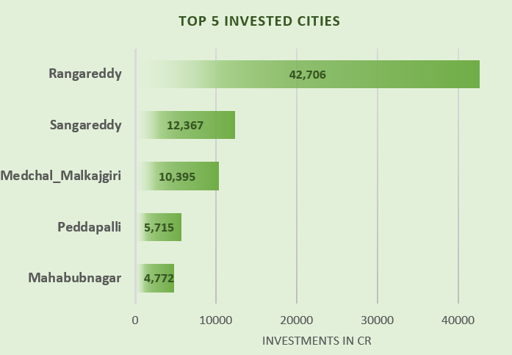
1. What are the top 5 districts to buy commercial properties in Telangana?
There are two approaches :
Sector-Based Investing
Growth-Based Investing
One can invest in either of these two for making profitable results.
Some investors may prefer a balanced approach that combines both sector-based and
growth-based strategies to diversify their commercial property

Slide 23
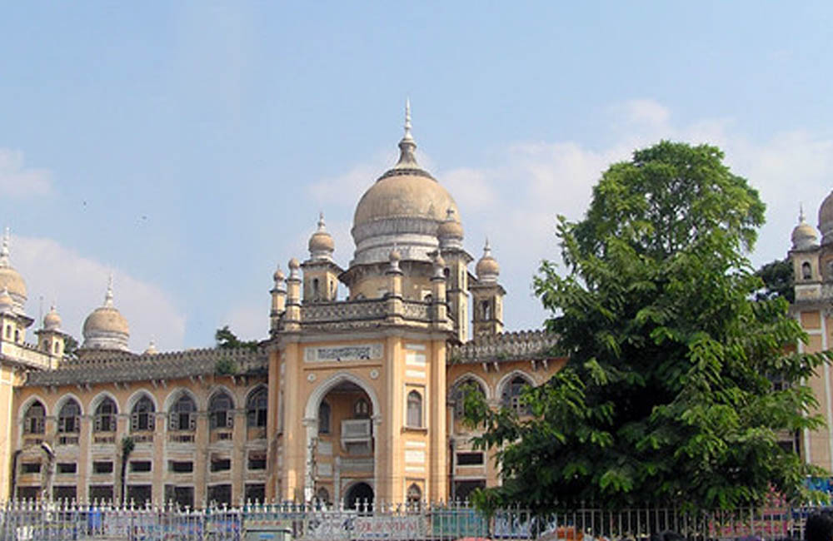
2. What significant policies or initiatives were put into effect to enhance economic growth, investments, and employment in Telangana by the current government?
Can we quantify the impact of these policies using available data?
Create a digital currency for the state:
Introduce state digital currency for efficient tracking, regulation, and direct citizen financial support.
Promote tourism: Boost tourism by creating new destinations and enhancing infrastructure to attract more visitors and boost the economy.
Invest in education and healthcare:
Enhance economic prospects by prioritizing education and healthcare investments, creating a skilled, healthy populace, and attracting businesses.
Invest in research and development:
Fuel economic growth with increased R&D investment, fostering innovation for new products and services in Telangana.

Slide 24
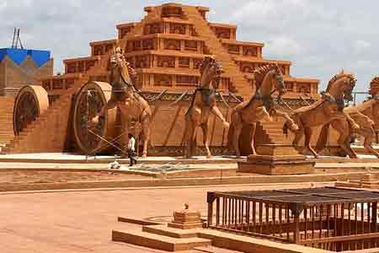
3. Top 5 Insights to Telangana government for sustained growth in the next 5 years based on my analysis.
Focusing and giving importance to all the districts because rangareddy is highly invested.
Telangana must prioritize sustainability through investments in renewable energy, energy efficiency, and sustainable agriculture practices.
Telangana should improve infrastructure to attract businesses and investors.
Telangana excels in pro-business policies, fostering investment from diverse sectors, showcasing a robust reform-driven approach, and attracting major companies.
Create a online platform for purchasing e-stams online.

Slide 25
I am really thankful for both codebasics team and Telangana government for providing this opportunity for me to provide these insights ☺

Slide 26
Thank you Mr. Dhaval Patel and Mr. Hemanand Vadivel for building this amazing Community.

Slide 27
THANKS FOR WATCHING !

